Slide 1
Discrete decision making
Lecture 4. Analytic hierarchy process

Slide 2
Intro
Decision problems involving a finite number of alternatives arise frequently in practice. The tools used to solve these problems depend largely on the type of data available (deterministic, probabilistic, or uncertain). The analytic hierarchy process (AHP) is a prominent tool for dealing with decisions under certainty, where subjective judgment is quantified in a logical manner and then used as a basis for reaching a decision. For probabilistic data, decision trees comparing the expected cost (or profit) for the different alternatives are the basis for reaching a decision. Decisions under uncertainty use criteria reflecting the decision maker’s attitude toward risk, ranging from optimism to pessimism. Another tool of decision under uncertainty is game theory, where two opponents with conflicting goals aim to achieve the best out of the worst conditions available to each.

Slide 3
Overall Idea of AHP: Example
Martin Hans, a bright high school senior, has received full academic scholarships from three institutions: U of A, U of B, and U of C. To select a university, Martin specifies two main criteria: location and academic reputation. Being the excellent student he is, he judges academic reputation to be five times as important as location, giving a weight of approximately 17% to location and 83% to reputation. He then uses a systematic analysis to rank the three universities front the standpoint of location and reputation. The following table ranks the two criteria for the three universities:
 | Percent weight estimates for universities
Criterion | U of A | U of B | Uof C
Location | 12.9 | 27.7 | 59.4
Reputation | 54.5 | 27.3 | 18.2

Slide 4
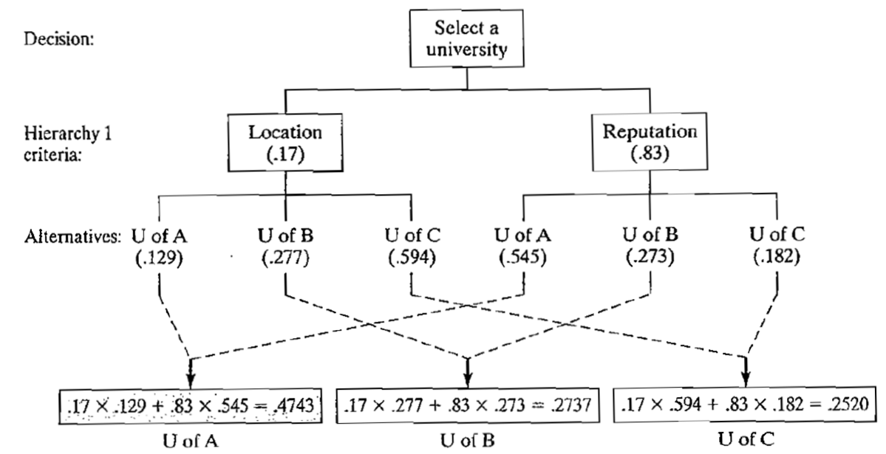
Graphical interpretation
The problem involves a single hierarchy (level) with two criteria (location and reputation) and three decision alternatives (U of A, U of B, and U of C).
The ranking of each university is based on computing the following composite weights:
U of A = .17 X .129 + .83 X .545 =.4743
U of B = .17 X .277 + .83 X .273 =.2737
U of C = .17 x .594 + .83 X .182 =.2520
Based on these calculations, U of A has the highest composite weight, and hence represents the best choice for Martin.

Slide 5
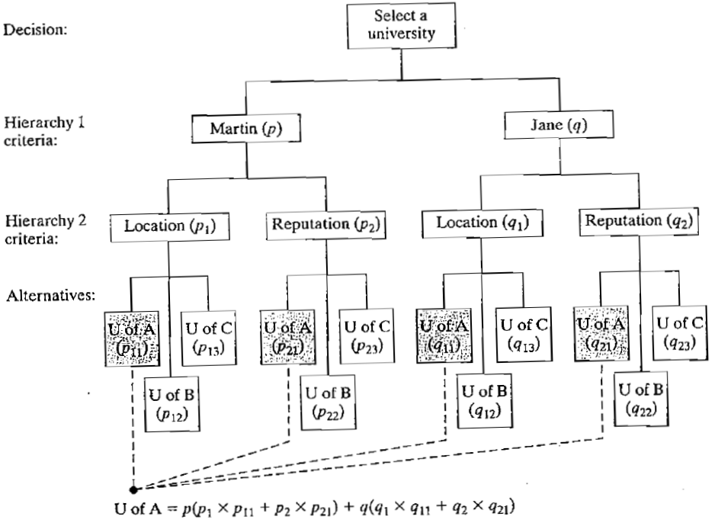
Two levels of hierarchy
Suppose in Example that Martin’s twin sister, Jane, was also accepted with full scholarship to the three universities. Their parents stipulate that they both must attend the same university so they can share one car. Figure summarizes the decision problem, which now involves two hierarchies. The values p and q (presumably equal) at the first hierarchy represent the relative weights given to Martin’s and Jane's opinions about the selection process. The second hierarchy uses the weights (p1,p2) and (q1,q2) to reflect Martin’s and Jane’s preferences regarding location and reputation of university. The remainder of the decision-making chart can be interpreted similarly. Note that p + q = 1, p1+p2=1, p11+p12+p13=1, p21+p22+p23=1 etc. The determination of the U of A composite weight, shown in figure, demonstrates the manner in which the computations are carried out.

Slide 6
Example
Suppose that the following weights are specified for the situation of Martin and Jane:
p = 0,5, q = 0,5,
p1 = 0,17, p2 = 0,83,
p11 = 0,129, p12 = 0,277, p13 = 0,594,
p21 = 0,545, p22 = 0,273, p23 = 0,182,
q1 = 0,3, q2 = 0,7,
q11 = 0,2, q12 = 0,3, q13 = 0,5, q21 = 0,5,
q22 = 0,2, q23 = 0,3

Slide 7
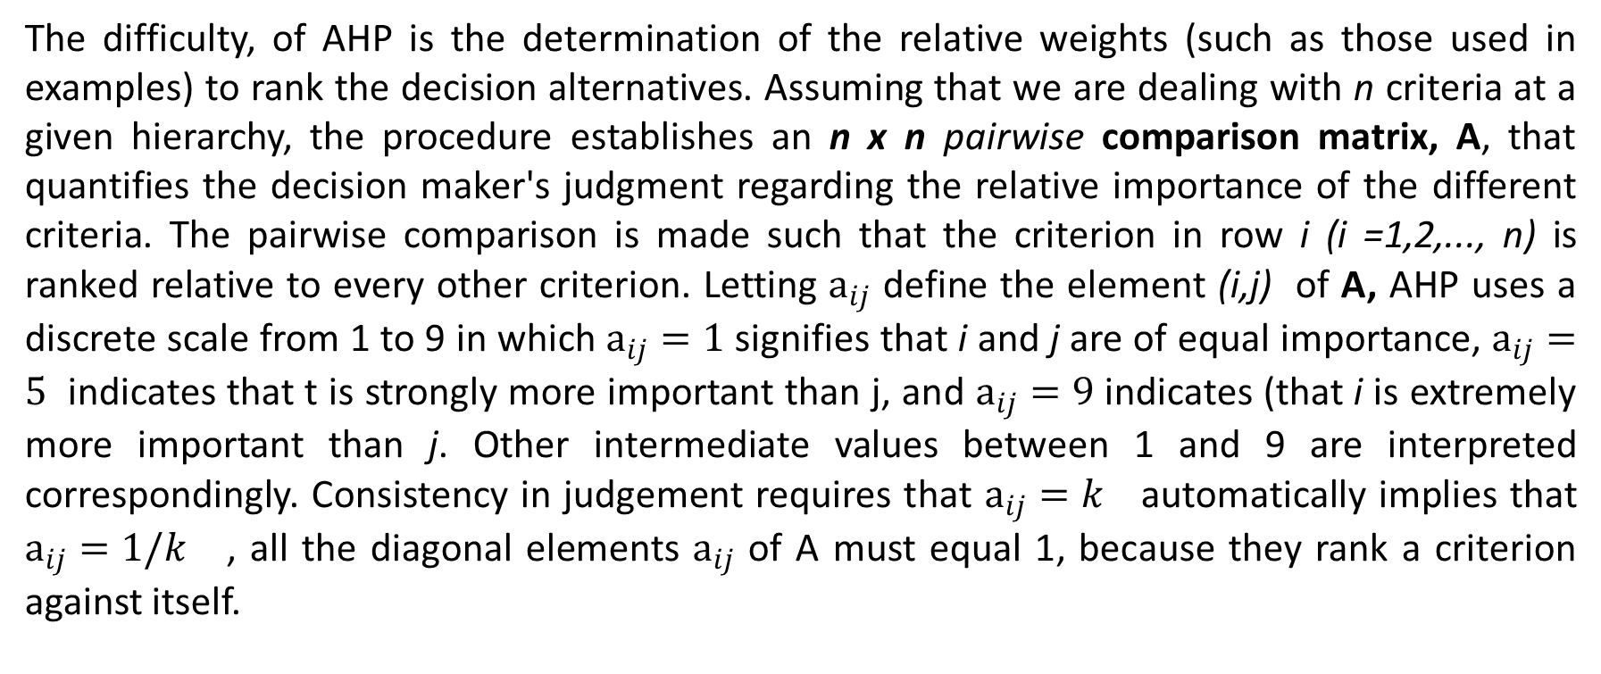
Determination of the Weights
The difficulty, of AHP is the determination of the relative weights (such as those used in examples) to rank the decision alternatives. Assuming that we are dealing with n criteria at a given hierarchy, the procedure establishes an n x n pairwise comparison matrix, A, that quantifies the decision maker's judgment regarding the relative importance of the different criteria. The pairwise comparison is made such that the criterion in row i (i =1,2,..., n) is ranked relative to every other criterion. Letting $a_{ij}$ define the element (i,j) of A, AHP uses a discrete scale from 1 to 9 in which $a_{ij}=1$ signifies that i and j are of equal importance, $a_{ij}=5$ indicates that t is strongly more important than j, and $a_{ij}=9$ indicates (that i is extremely more important than j. Other intermediate values between 1 and 9 are interpreted correspondingly. Consistency in judgement requires that $a_{ij}=k$ automatically implies that $a_{ij}=1/k$ , all the diagonal elements $a_{ij}$ of A must equal 1, because they rank a criterion against itself.

Slide 8
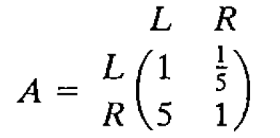
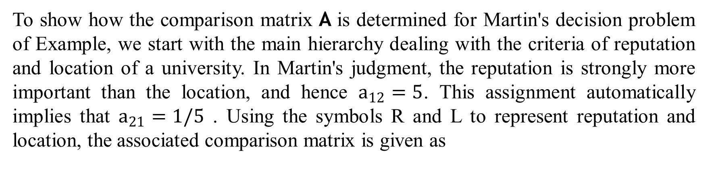
Determination of the Weights: Example (1/2)
To show how the comparison matrix A is determined for Martin's decision problem of Example, we start with the main hierarchy dealing with the criteria of reputation and location of a university. In Martin's judgment, the reputation is strongly more important than the location, and hence $a_{12}=5$. This assignment automatically implies that $a_{21}=1/5$ . Using the symbols R and L to represent reputation and location, the associated comparison matrix is given as

Slide 9
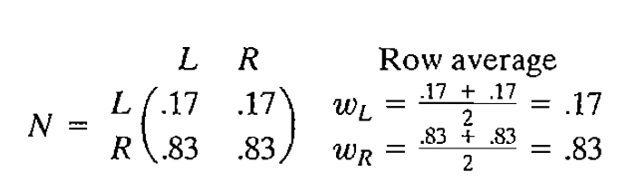
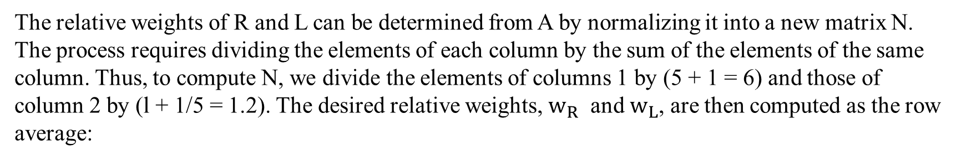
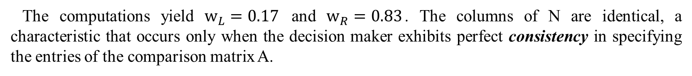
Determination of the Weights: Example (2/2)
The relative weights of R and L can be determined from A by normalizing it into a new matrix N. The process requires dividing the elements of each column by the sum of the elements of the same column. Thus, to compute N, we divide the elements of columns 1 by (5 + 1 = 6) and those of column 2 by (l + 1/5 = 1.2). The desired relative weights, $w_{R}$ and $w_{L}$, are then computed as the row average:
The computations yield $w_{L}=0.17$ and $w_{R}=0.83$. The columns of N are identical, a characteristic that occurs only when the decision maker exhibits perfect consistency in specifying the entries of the comparison matrix A.

Slide 10
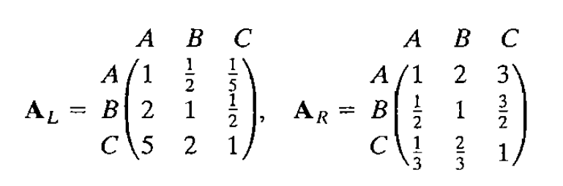
Weights of alternative (1/2)
The relative weights of the alternatives U of A, U of B, and U of C are determined within each of the L and R criteria using the following two comparison matrices, whose elements are based on Martin's judgment regarding the relative importance of the three universities

Slide 11
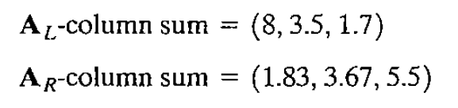
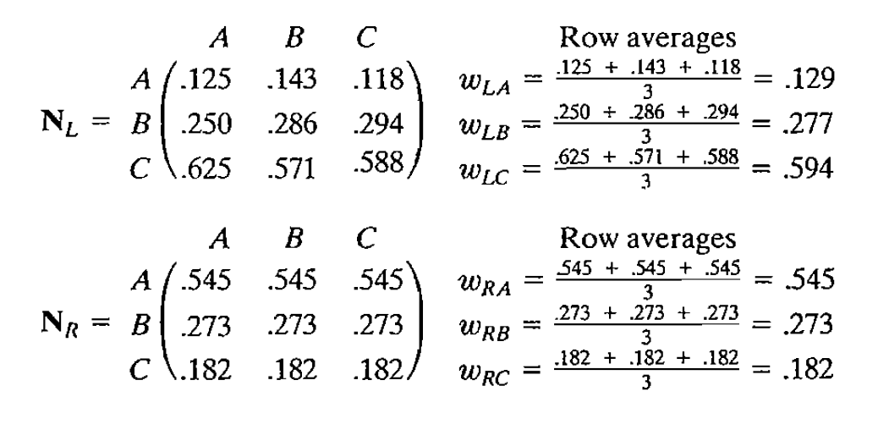
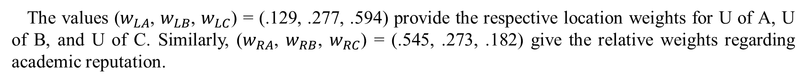
Weights of alternative (1/2)
Summing the columns, we get
The following normalized matrices are determined by dividing all the entries by the respective column-sums:
The values ($w_{LA}$, $w_{LB}$, $w_{LC}$) = (.129, .277, .594) provide the respective location weights for U of A, U of B, and U of C. Similarly, ($w_{RA}$, $w_{RB}$, $w_{RC}$) = (.545, .273, .182) give the relative weights regarding academic reputation.

Slide 12
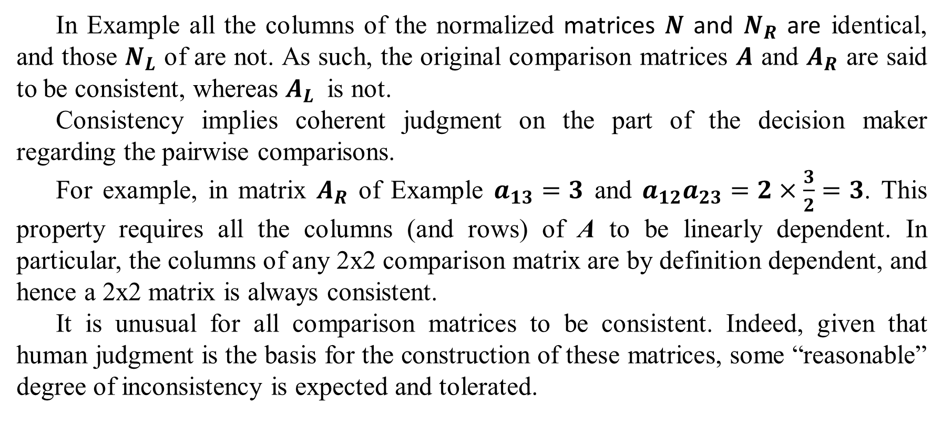
Consistency of the Comparison Matrix
In Example all the columns of the normalized matrices $N$ and $N_{R}$ are identical, and those $N_{L}$ of are not. As such, the original comparison matrices $A$ and $A_{R}$ are said to be consistent, whereas $A_{L}$ is not.
Consistency implies coherent judgment on the part of the decision maker regarding the pairwise comparisons.
For example, in matrix $A_{R}$ of Example $a_{13}=3$ and $a_{12}a_{23}=2×\frac{3}{2}=3$. This property requires all the columns (and rows) of A to be linearly dependent. In particular, the columns of any 2x2 comparison matrix are by definition dependent, and hence a 2x2 matrix is always consistent.
It is unusual for all comparison matrices to be consistent. Indeed, given that human judgment is the basis for the construction of these matrices, some “reasonable” degree of inconsistency is expected and tolerated.

Slide 13
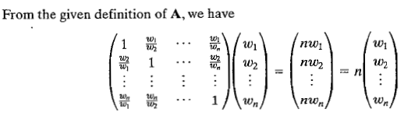
Consistency of the Comparison Matrix
To determine whether or not a level of consistency is “reasonable,” we need to develop a quantifiable measure for the comparison matrix A. We have seen in Example that a perfectly consistent A produces a normalized matrix N in which all the columns are identical.
Given that w is the column vector of the relative weights i=1,2..N, A is consistent if

Slide 14




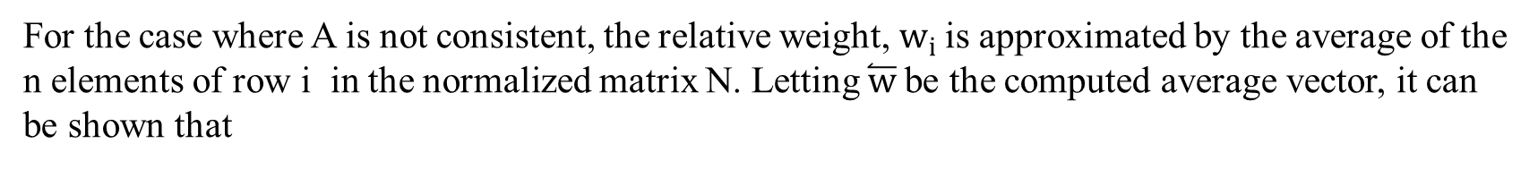
Consistency of the Comparison Matrix
For the case where A is not consistent, the relative weight, $w_{i}$is approximated by the average of the n elements of row i in the normalized matrix N. Letting $\overset{⃐}{w}$be the computed average vector, it can be shown that
In this case, the closer n_{max} is to n, the more consistent is the comparison matrix A. Based on this observation, AHP computes the consistency ratio as
where
The random consistency index, RI, was determined empirically as the average CI of a large sample of randomly generated comparison matrices, A.
If CR <= 0.1, the level of inconsistency is acceptable. Otherwise, the inconsistency is high and the decision maker may need to reestimate the elements of A to realize better consistency.

Slide 15

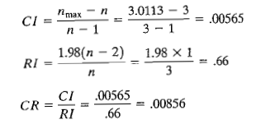

Example
From Example we have
Thus,
This yields
Hence, for n=3,
Because CR<0.1, the level of inconsistency in $A_{L}$
is acceptable.

Slide 16
Weights of alternative (2/2)
The relative weights of the alternatives U of A, U of B, and U of C are determined within each of the L and R criteria using the following two comparison matrices, whose elements are based on Martin's judgment regarding the relative importance of the three universities

